Slide 1
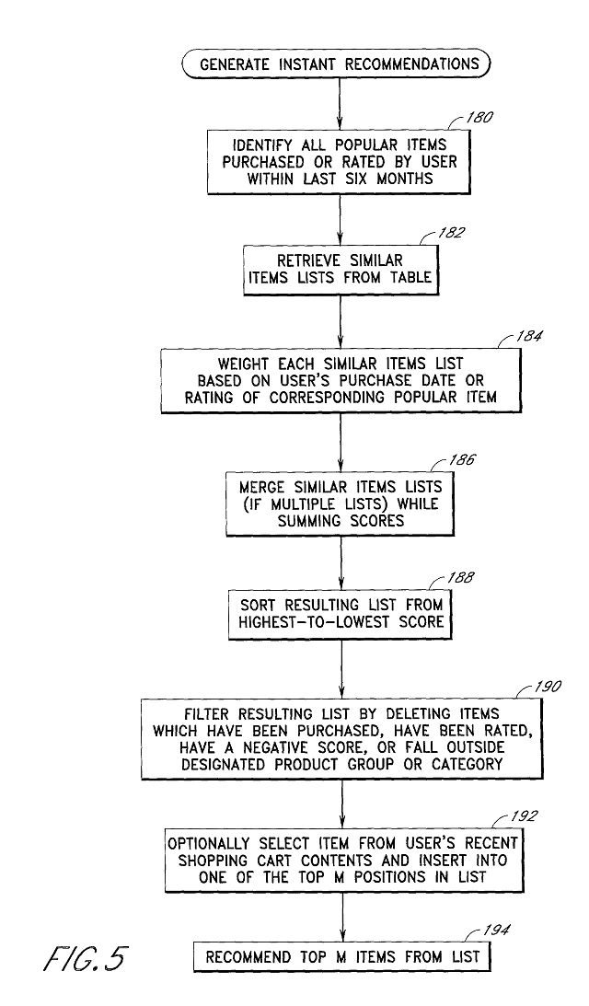
Algorithmic Bias – The Hidden Danger
What is Bias?: When a model produces systematically prejudiced results against certain groups of people.
The Source: Bias usually enters through the Training Data. If your historical data contains human prejudice (e.g., historical loan denials for certain districts), the AI will learn and amplify that prejudice.
Types of Bias:
Selection Bias: The data doesn't represent the whole population.
Label Bias: The "Success" metric is flawed.
The Goal: Fairness. A data scientist must audit their data to ensure it doesn't discriminate based on gender, race, or geography.

Slide 2
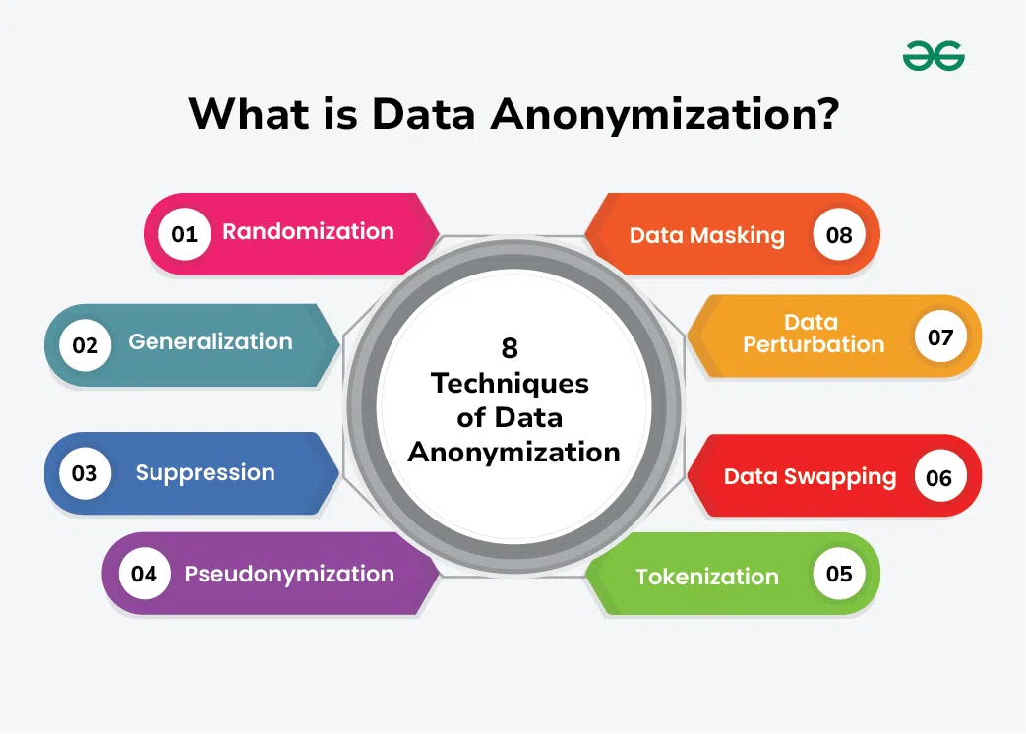
Data Privacy & Anonymization
The Responsibility: Handling personal information (PII) like names, addresses, or medical IDs requires extreme care.
GDPR Standards: The global benchmark for data protection. It grants users the "Right to be Forgotten."
Anonymization Techniques:
Masking: Replacing sensitive data with characters (e.g., zaryab@email.com → z****@email.com).
Pseudonymization: Replacing names with unique IDs.
Aggregation: Showing "Average Salary per District" instead of individual salaries.

Slide 3

The "Final Pitch" – Speaking to the Board
The Language Gap: CEOs and Managers care about Value, Risk, and Cost, not P-values or Hyperparameters.
The Structure:
The Hook: What problem did we solve?
The Evidence: Show the most impactful visualization (The "Hero Chart").
The Recommendation: What should the company do tomorrow?
Simplicity: If you can't explain your model to someone who doesn't know Python, you don't understand your model well enough.

